Slide 1
项目架构设计
App
login
project
test
upload
Base: baseV、 baseMV、 baseM 等
Common： commondapter、
Common
Network
Base

Slide 2
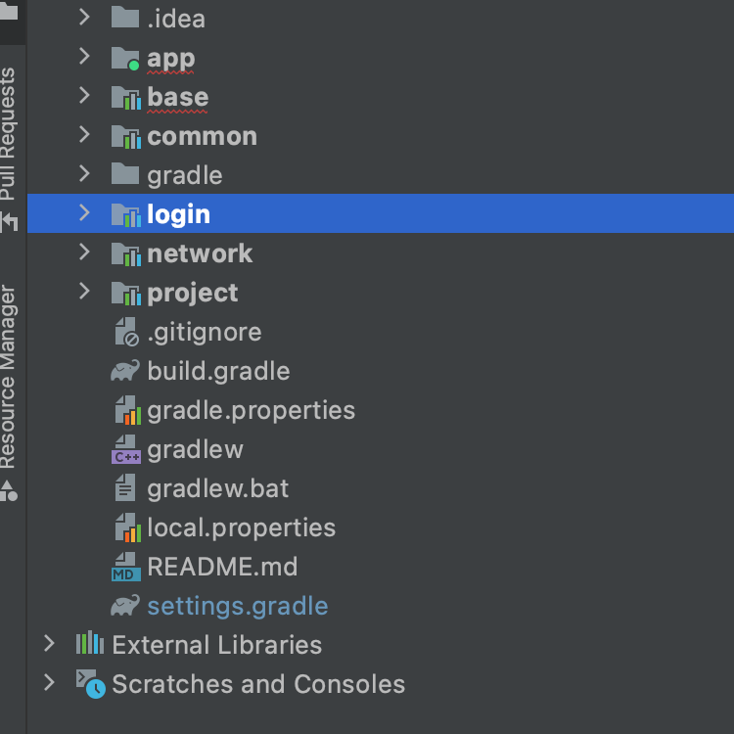
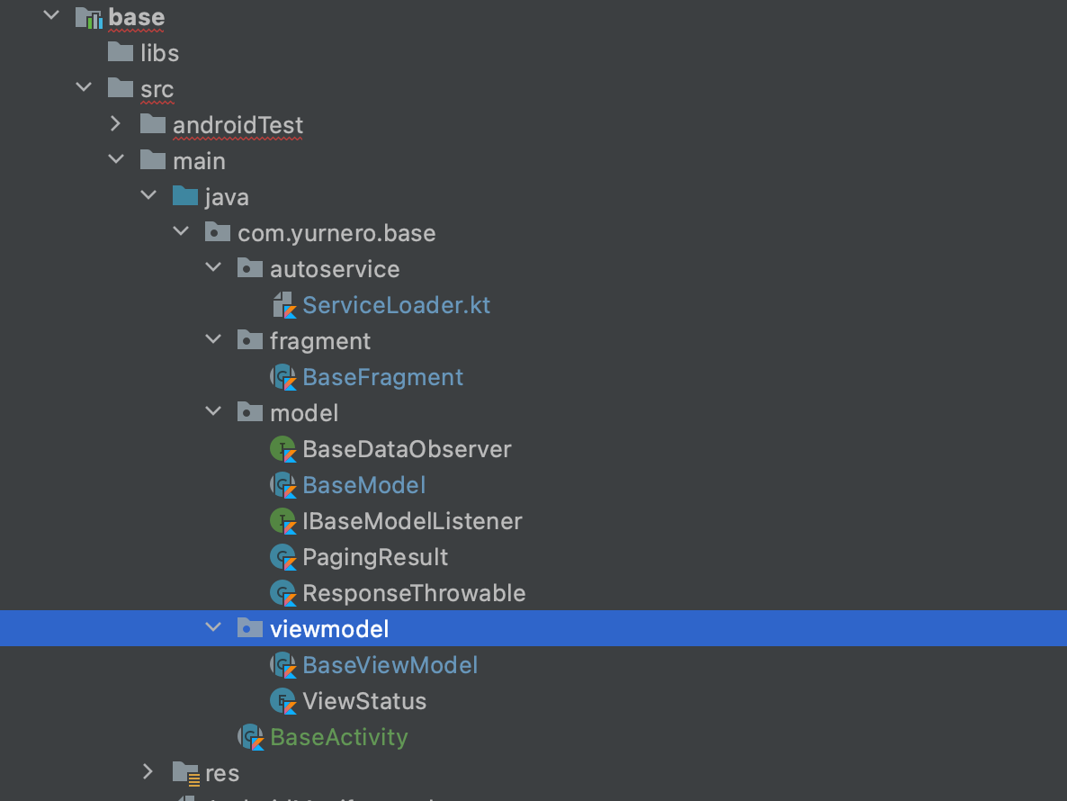

Slide 3
Base模块设计
BaseFragment<VIEW extands ViewDataBinding, VIEW_MODEL extands BaseViewModel>Fragment(), Observer<Any>
override fun onChanged(t: Any)
override fun onCreateView
abstract fun getLayoutId(): Int abstract fun createViewModel(): BaseViewModel<*> abstract fun bindData(data: ArrayList<*>)
BaseViewModel<RESULT_DATA>(SavedStateHandle) extends IBaseModelListener,ViewModel
LiveData RESULT_DATA, errorMsg, status
open fun fresh () open fun nextPage()
override fun onCleared()
override fun onLoadSuccess
override fun onLoadFail
abstract fun createModel(savedStateHandle: SavedStateHandle): BaseModel<*, RESULT_DATA>
enum ViewStatus
BaseModel<NETWORK_DATA, RESULT_DATA>(IBaseModelListener, cacheKey) open fun fresh()
open fun loadNextPage()
open fun addDisposable(d: Disposable?)
open fun clear()
abstract fun load()
interface IBaseModelListener<RESULT_DATA> fun onLoadSuccess
fun onLoadFail

Slide 4
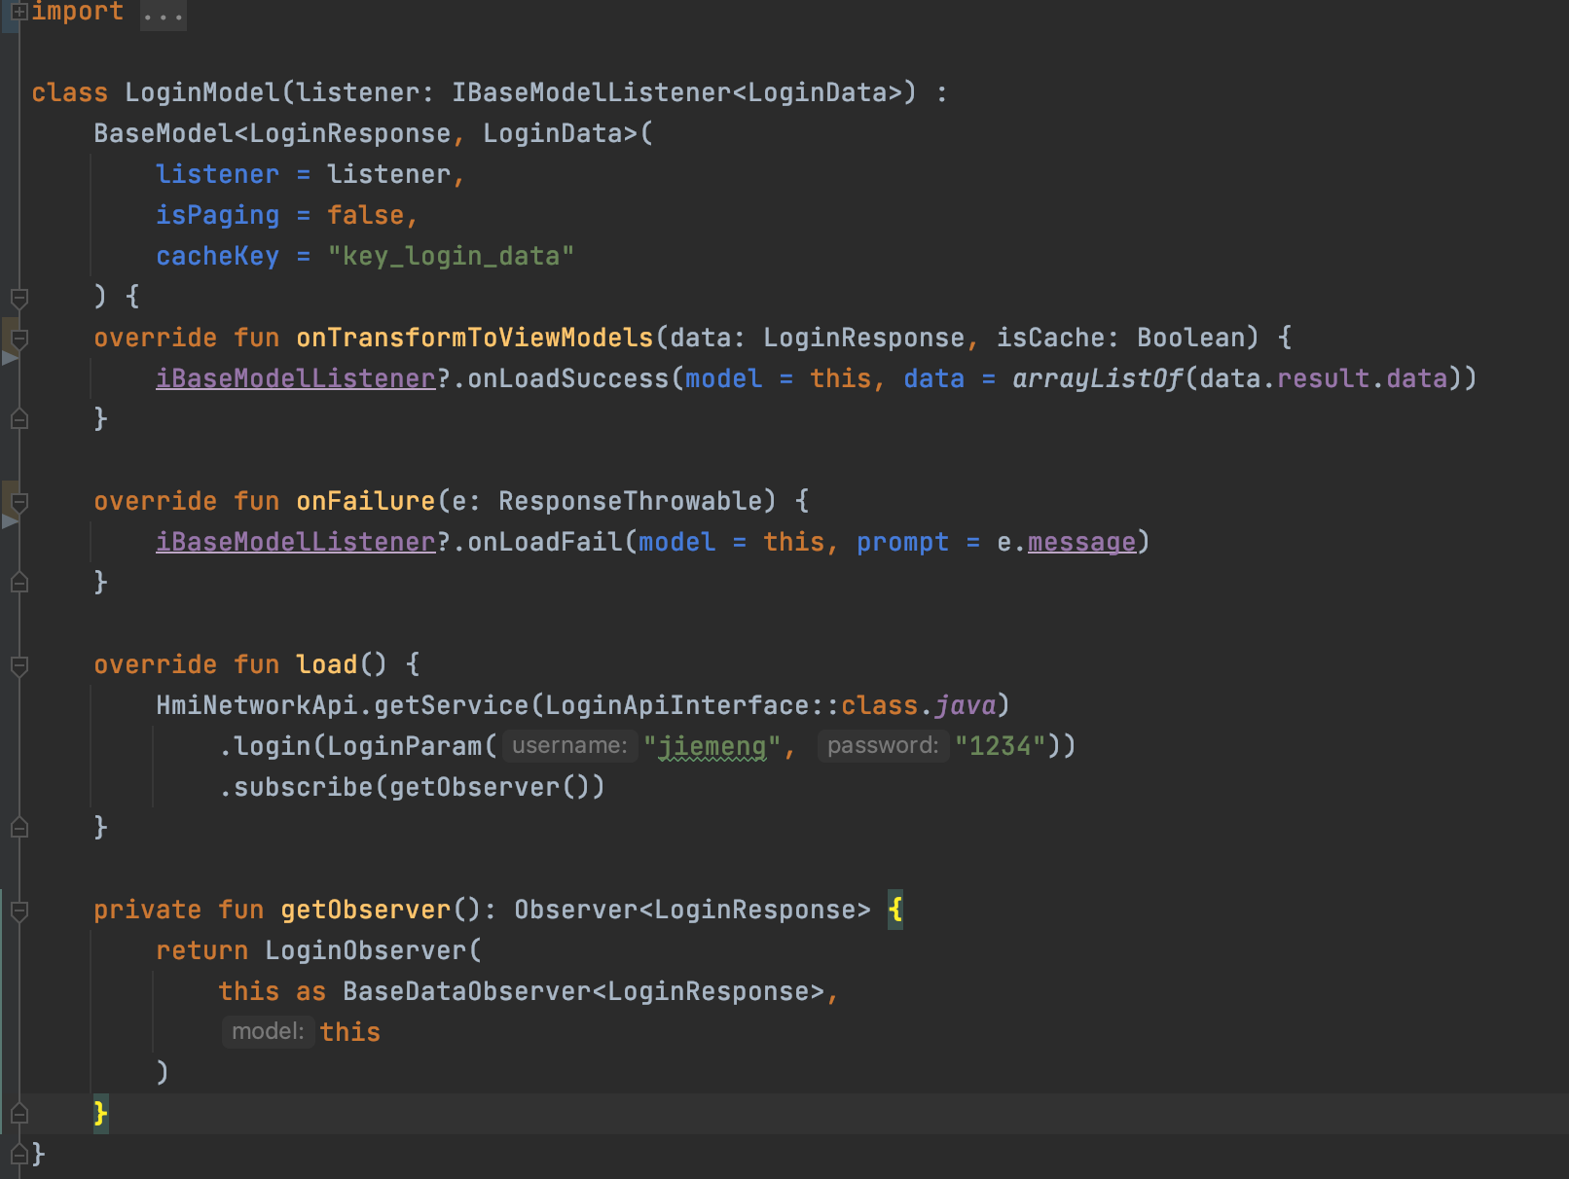
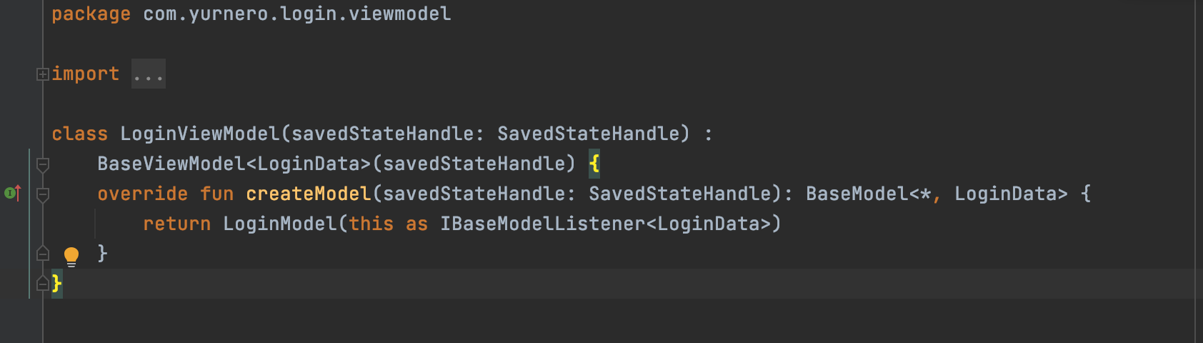
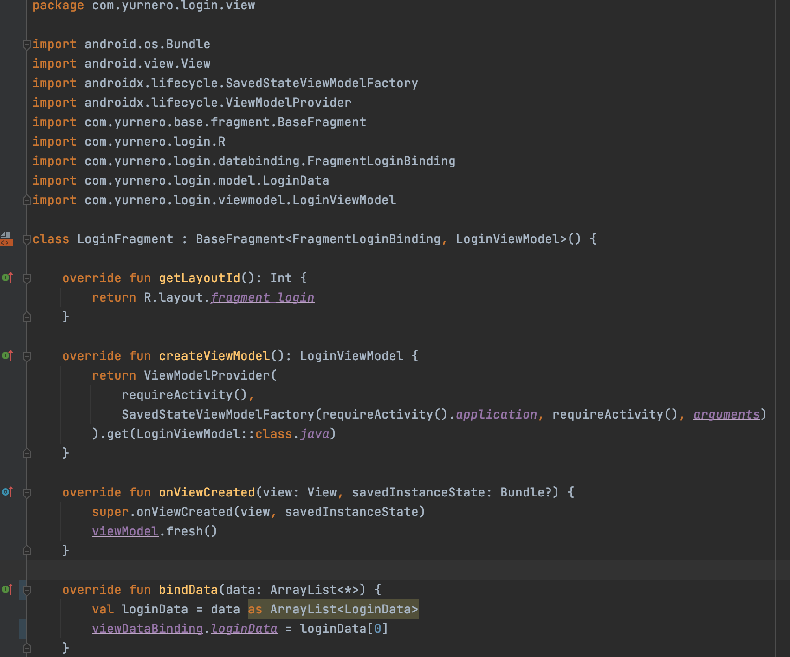

Slide 5
App
Network模块设计
init
Login的Model
服务端
Api
response
Retrofit
RxJava
okhttp
请求网络
请求和返回的拦截器
network
Base

Slide 6
